Slide 1



BANK MARKETING CAMPAIGN
MACHINE LEARNING
by Ammar Muzaki
LINKEDIN.COM/IN/AMMAR-MUZAKI/
AMMARMUZAKI@GMAIL.COM
GITHUB.COM/ZACKY182

Slide 2

The Outline
Bank Marketing Campaign Machine Learning
Data Preparation, Feature Engineering,
Feature Selection
Business Explanation and Prediction
1
Analytic Approach
3
5
7
2
4
6
Business Understanding
Data Understanding
Modeling
Conclusion and Recommendation

Slide 3


BUSINESS UNDERSTANDING
Business Statement
The banking industry offers a variety of financial products, notably term deposits, where customers deposit money for a set period in exchange for a fixed interest rate. To remain competitive, banks use marketing campaigns to retain and attract new customers.
01
Simplified Scenario
Potential Marketing Cost per Customer: $2,39
Profit per Customer: $45,00
Business Problem
XY Bank's campaigns to encourage term deposits have been ineffective, resulting in significant resource wastage. To improve this, the bank's marketing team plans to develop a predictive system using historical data and customer behavior to accurately forecast deposit interest. This system aims to reduce errors, making future campaigns more targeted, efficient, and cost-effective.
02

Slide 4





ANALYTICAL APPROACH
To improve marketing campaign effectiveness for fixed-term deposits, XY Bank has chosen PRECISION as the primary evaluation metric for its predictive model and add Return on Investment (ROI) Matrix for measuring the profitability of an investment compared to its cost.
01
Target :
0 = Customers did not open a fixed-term deposit
1 = Customers opened a fixed-term deposit
02
Business Objectives
Minimize Marketing Waste
Increase Conversion Rates:
Goals
Optimize Marketing Budget
Drive Revenue Growth up to 10%
03

Slide 5










DATA UNDERSTANDING
Feature Information
Detailed attributes of each feature, such as age, job, balance, housing status, loan status, contact method, campaign details, and previous outcomes, are provided to understand their relevance to predicting term deposit subscriptions.
Outtliers
Identifying and assessing outliers in features such as age, balance, campaign, and pdays to understand their potential impact on model performance and decision-making.
Data Cleaning
Missing values and inconsistencies are addressed, checking categorical variables a and numerical features are scaled to ensure the dataset is suitable for model training.
Correlations
Analysis reveals the relationships between features, highlighting which attributes have a significant impact on the likelihood of a customer subscribing to a term deposit.

Slide 6
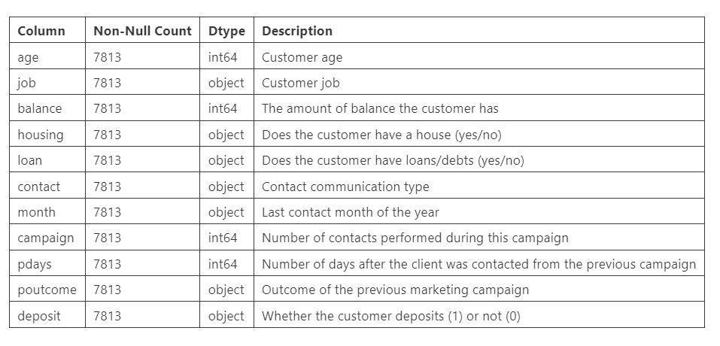
DATA UNDERSTANDING
Feature Information
There are 7,813 rows and 11 columns, each with specific descriptions as outlined below.

Slide 7
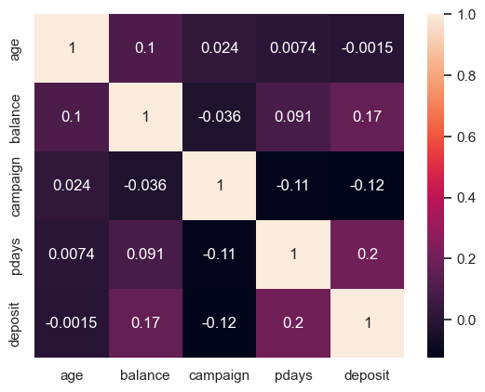
DATA UNDERSTANDING
Correlations
Age and Balance (0.1).
Balance and Deposit Binary (0.17).
Campaign and Deposit Binary (-0.12).
Pdays and Deposit Binary (0.22)
Pdays and Campaign (-0.12).
Age correlates weakly positively with balance, balance weakly positively affects deposit likelihood, campaigns show a negative correlation with deposit likelihood, and longer gaps between contacts positively influence deposit probability but decrease campaign intensity.

Slide 8
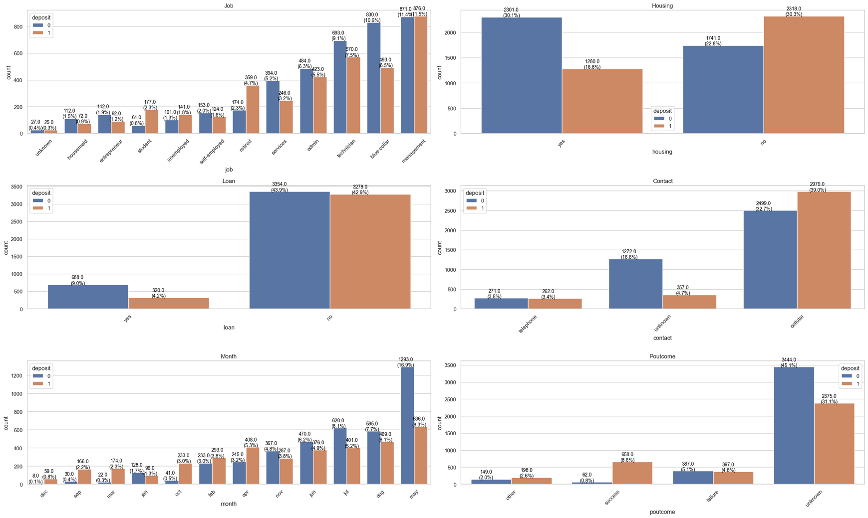
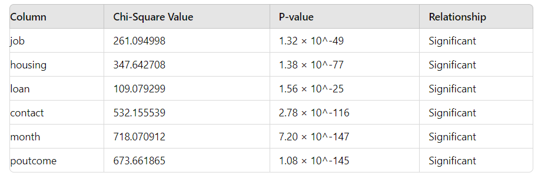
DATA UNDERSTANDING
All examined categorical features—job, housing loan, personal loan, contact method, month of contact, and previous campaign outcome—significantly impact the likelihood of subscribing to a term deposit.

Slide 9
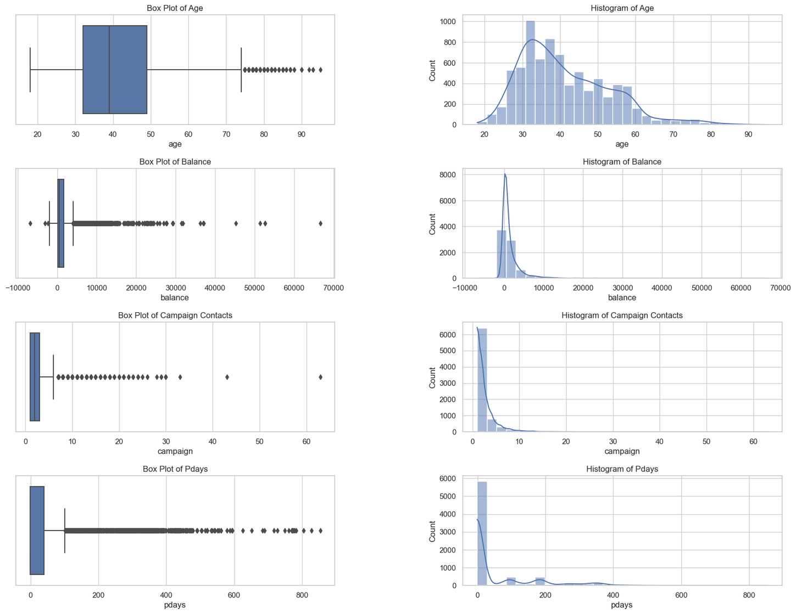
DATA UNDERSTANDING
Outtliers
Identifying and assessing outliers in features such as age, balance, campaign, and pdays to understand their potential impact on model performance and decision-making
.
age: {'Lower Outliers': 0, 'Upper Outliers': 121},
balance: {'Lower Outliers': 3, 'Upper Outliers': 733},
campaign: {'Lower Outliers': 0, 'Upper Outliers': 429},
pdays: {'Lower Outliers': 0, 'Upper Outliers': 1454}

Slide 10










DATA UNDERSTANDING
Data Cleaning
Drop Row
Checking Duplicate
Checking Null and Missing Values
Checking Whitespace
Diminishing Returns Beyond 365 Days in pDays: The sharp drop in conversion rates beyond 365 days, particularly past 720 days, suggests that the effectiveness of contact diminishes significantly with time.
Drop Row on PDAYS over than 365
- 96.41% of 'yes' deposits occur within the first 365 days.
- 3.40% of 'yes' deposits occur between 365 to 720 days.
- Only 0.24% of 'yes' deposits occur after 720 days.

Slide 11



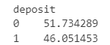



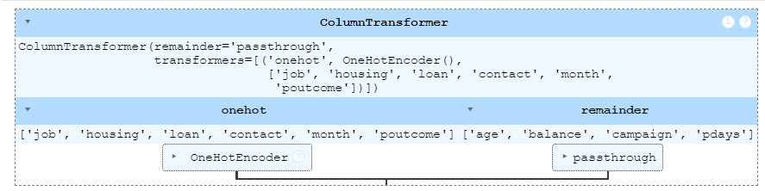


Scaling the Data
The StandardScaler is used to standardize the features by removing the mean and scaling to unit variance.
with_mean=False: This parameter is set to False to handle sparse matrices. When dealing with sparse matrices, centering the data would break the sparsity and could be very memory inefficient. Therefore, this parameter ensures that the data is scaled but not centered.
Distribution of the Target Variable
Data Preparation, Feature Engineering,
Feature Selection
Fit and Transform Training/Test Data
Extracting Feature Names
These lines fit the ColumnTransformer to the training data, learning the categories of the categorical features, and then transform the testing data according to the fitted ColumnTransformer.
This line retrieves the feature names after the transformation, which includes the one-hot encoded categorical features and the original numerical features.
Performing Recursive Feature Elimination (RFE)
Identifying the most significant features that contribute to the model's performance.
Transform and Scale Data

Slide 12






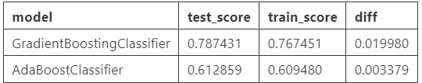
Modeling
Process to Get Best Score and Model
5
Set Threshold Optimize as Final Model
Threshold Optimize
4
best precision score : 0.9227467811158798
best threshold : 0.79
Test Precision: 0.9122807017543859
Hyperparameter Tuning (GBC and ADA)
3
GBC Test Precision: 0.7701375245579568
ADA Test Precision: 0.6147308781869688
Recursive Feature Elimination (GBC)
2
Test Precision: 0.7661870503597122
1
Benchmark Model

Slide 13


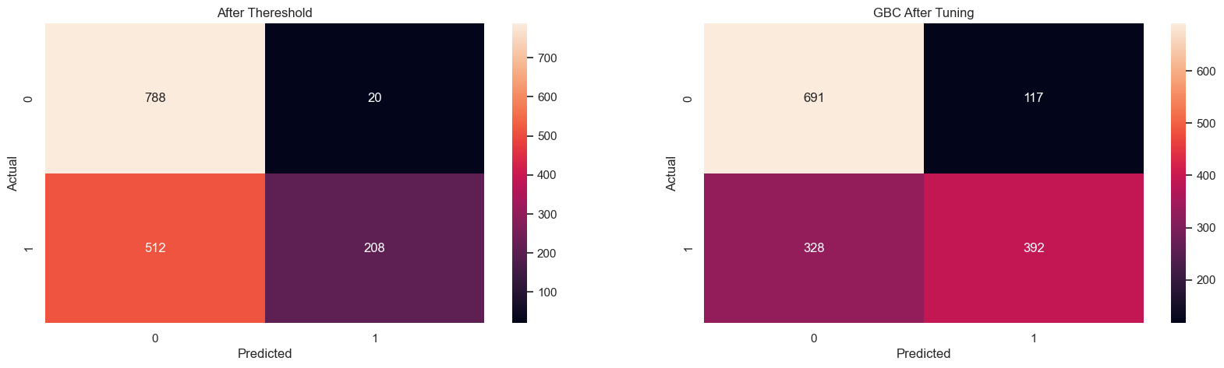



Modeling
Predict Probabilities
1
Use the trained model benchmark to predict the probabilities of the positive class
Threshold Optimize
Threshold Adjustment
2
Iterate over a range of threshold values to find the one that maximizes the precision score.
TN
FP
Predict with Optimal Threshold
3
Use the optimal threshold to make final predictions and evaluate the precision score.
In this case, by increasing the threshold to 0.79, we prioritize precision
Precision Improvement
4
improved the precision for class 1 (depositors) from 0.7874 to 0.9123.
FN
TP
Trade-Off with Recall
5
The recall for class 1 decreased from 0.59 to 0.29, meaning the model missed more actual depositors
Confusion Matrix
6
The number of true positives decreased from 426 to 208, and the number of false negatives increased from 294 to 512.

Slide 14
1
Initial Model Training
How GradientBoosting Final Works?
2
Hyperparameter Tuning
Explanation of the Final Model and its Optimization
3
Predict with Optimal Threshold
The Gradient Boosting Classifier works by sequentially building an ensemble of decision trees, each correcting the errors of its predecessors. In our project, after benchmarking and identifying it as the best model, we optimized it through hyperparameter tuning and threshold adjustment. This comprehensive approach ensured that we achieved the highest precision, meeting the business objectives of reducing marketing waste and increasing conversion rates.

Slide 15
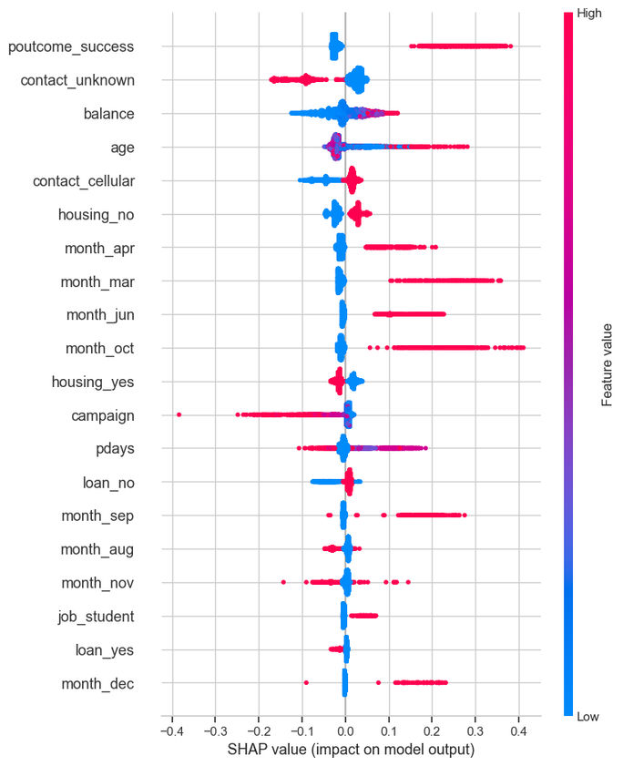
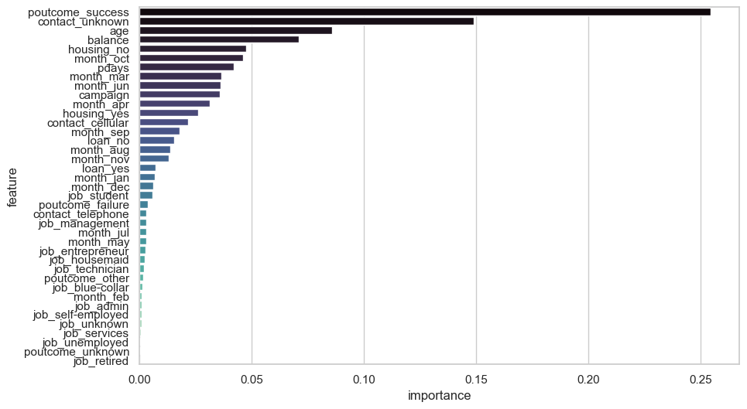
Feature Importance
Threshold Optimize

Slide 16

BUSINESS EXPLANATION
AND
PREDICTION
BANK MARKETING CAMPAIGN BY MUZAKI AMMAR

Slide 17
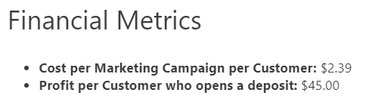
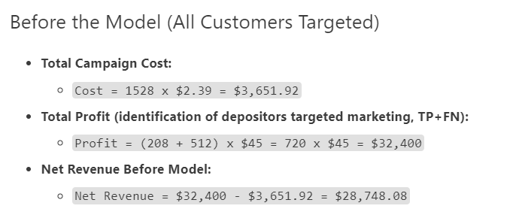
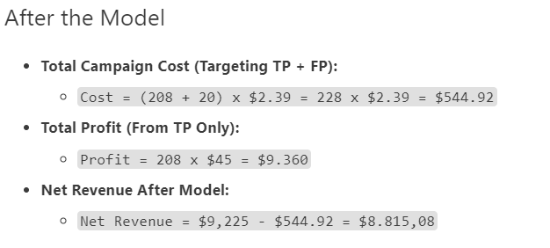
BUSINESS EXPLANATION
TN
FP
BANK MARKETING CAMPAIGN BY MUZAKI AMMAR
FN
TP

Slide 18


Judging by Net Income alone, it may appear that the profits are higher before implementing the model.
However, is that truly the case? Lets Calculate with ROI Matrix

Slide 19


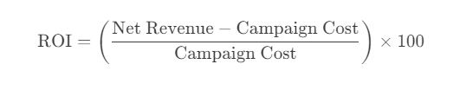
RETRUN OF INVESTMENT
What is ROI
Return on Investment (ROI) measures the profitability of an investment compared to its cost.
Interpretation of ROI
An ROI of 100% means you've earned back exactly what we spent, resulting in no net loss or gain.

Slide 20
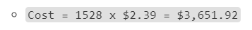
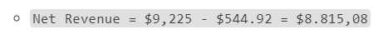
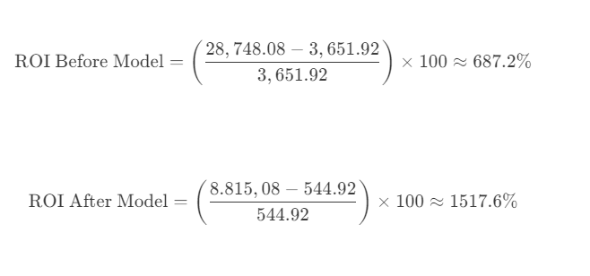
RETRUN OF INVESTMENT
Increase in ROI
The ROI increased by approximately 120.88% after the model's implementation.

Slide 21
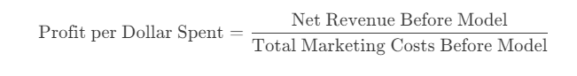
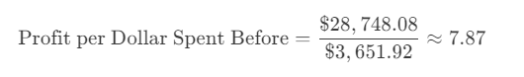
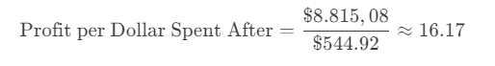
PROFIT PERSPECTIVE IN DOLLARS SPENT
Efficient Profit Making
Though the absolute profit is lower, the profit efficiency (profit per dollar spent on marketing) is significantly higher with the model.
The profit efficiency per dollar spent on the marketing campaign increased by approximately 105.4% after the model's implementation.

Slide 22













Why is Profit Efficiency Higher After Using the Model?
Reduced Costs
Targeting only those most likely to convert into depositors
Higher ROI
The return on investment (ROI) is considerably higher after using the model
Focused Targeting
By focusing on a smaller, more likely-to-convert group, the marketing efforts are not wasted.

Slide 23



Conclusion
Solutions Provided
The primary objective was to predict customer behavior for term deposit subscriptions and optimize the marketing strategy using a Gradient Boosting Classifier, fine-tuned through threshold optimization. The final model demonstrated strong performance with a high precision score. Key metrics, such as ROI and marketing cost savings, validated the model's effectiveness in enhancing targeted marketing efforts.
Measurable Outcomes
The implementation of the Gradient Boosting Classifier significantly improved the precision of predicting customers likely to subscribe to term deposits.
ROI calculations highlighted substantial cost savings and higher profit efficiency.
Before using the model, the net revenue was $28,748.08 with an ROI of 687.2%, whereas,
After using the model, the net revenue was $8,815.08 with an ROI of 1517.6%.
The model's precision increased from 0.7874 to 0.9123, indicating a more accurate identification of potential depositors.
This approach resulted in significant cost savings, reducing marketing costs from $3,651.92 to $544.92, thus demonstrating clear financial benefits for XY Bank.

Slide 24
RECOMMENDATIONS
BUSINESS
MODEL IMPROVEMENT
Minimize Marketing Waste: By improving precision, the bank reduces ineffective customer engagements, cutting costs and increasing revenue.
Increase Conversion Rates: Focusing on statistically likely customers for fixed-term deposits enhances campaign efficiency. Emphasize key features like poutcome_success, contact_unknown, age, and balance in strategies and predictive models to improve targeting.
Optimize Marketing Budget: Targeting the right customers lowers overall campaign costs by avoiding spending on unlikely depositors.
Drive Revenue Growth: Precision targeting not only saves money but also boosts revenue by focusing on profitable customer segments.
1. Data Collection and Enrichmen
Loyalty and Rewards
Customer Relationship Duration
Account Activity
2020
2. Model Improvement
Explore advanced machine learning algorithms, including deep learning.
Implement robust cross-validation and regularization methods to prevent overfitting.
Conduct detailed segmentation analysis to tailor strategies for different customer groups.
Continuously monitor and evaluate model performance in real-time to identify improvements.
Implement feature engineering techniques to capture more customer behavior patterns.
Use A/B testing to refine and validate targeted marketing strategies.

Slide 25

THANK YOU
CONTACT
LINKEDIN.COM/IN/AMMAR-MUZAKI/
AMMARMUZAKI@GMAIL.COM
GITHUB.COM/ZACKY182

